Slide 1



The LJMU Experience
Introduction to ChatGPT &
Why is it the most in-demand skill today?
Arsalan Anwar
Data Scientist
Course5 Intelligence

Slide 2
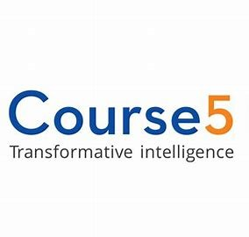


About Me
I am currently working as a Data Scientist at Course5 Intelligence where I am involved in handling various CPG projects ranging from customer lifetime value prediction, risk analytics, churn prediction, etc. Prior to joining Course5, I was a part of West Pharmaceutical Services where I was instrumental in developing autonomous navigation robots using Deep Reinforcement Learning which transport raw and packaged materials from one location to another.
I am also the Founder and Researcher at Data Science Crew which is a platform for data science enthusiasts to collaborate, research and work on exciting AI/ML problems
Arsalan Anwar
LinkedIn: https://www.linkedin.com/in/arsalan-anwar-ai/

Slide 3

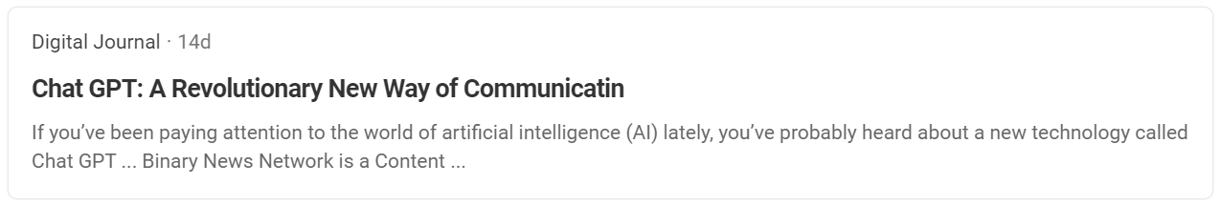

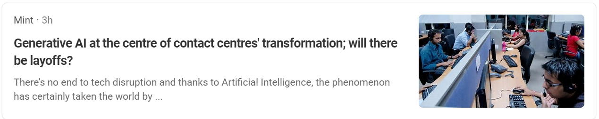
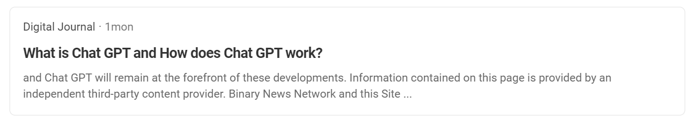
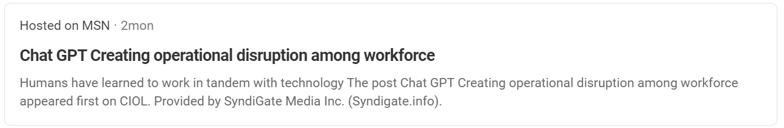
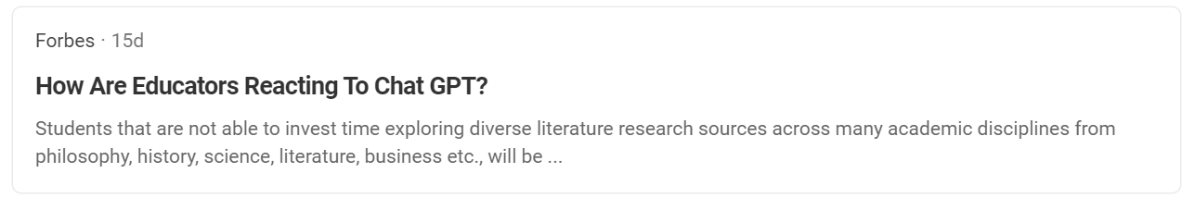
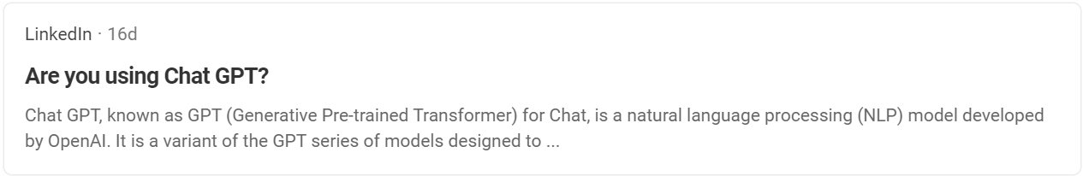
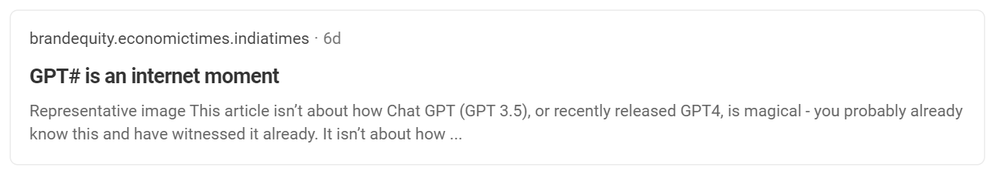
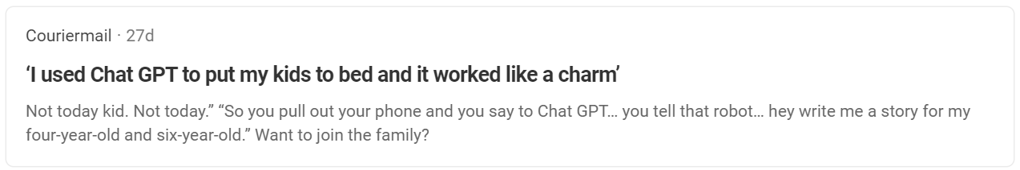
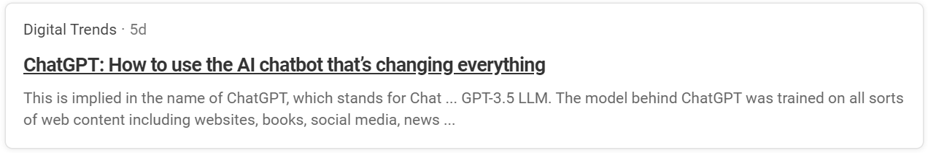
Practice in teams of 4 students
Industry expert mentoring to learn better
Get personalised feedback for improvements
3

Slide 4







Agenda
Generative AI and Large Language Models (LLM)
What is ChatGPT & How does it work?
Why is ChatGPT the most in-demand skill today?
How ChatGPT is transforming the future of industries
Prompt Engineering: Are you using effective prompts?
Build your Custom Chatbot

Slide 5
Generative AI and Large Language Models (LLMs)
Practice in teams of 4 students
Industry expert mentoring to learn better
Get personalised feedback for improvements
9

Slide 6
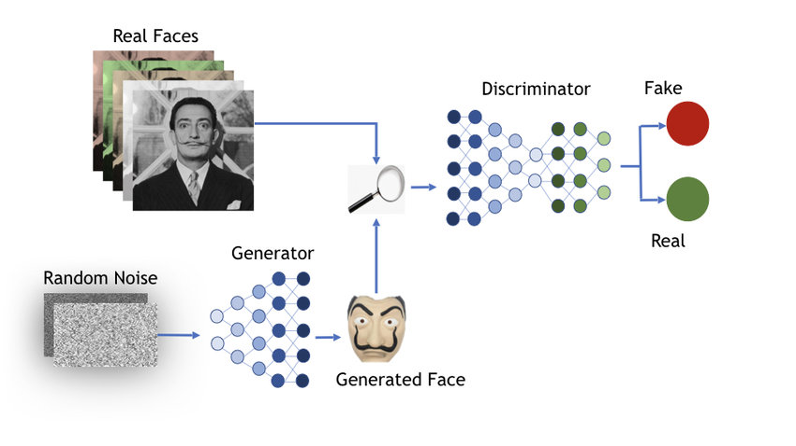
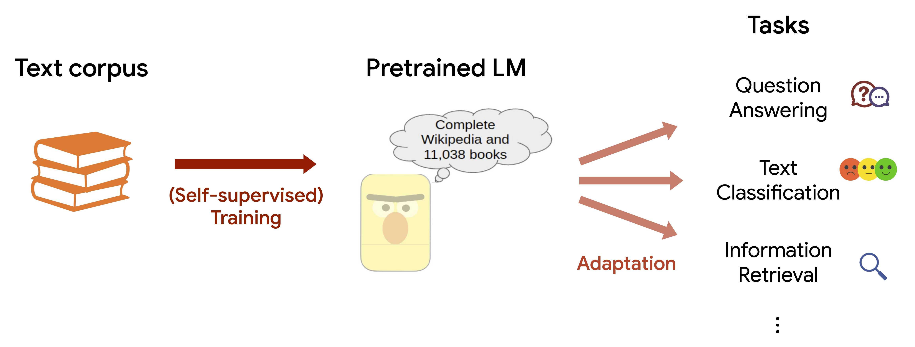
Understanding Generative AI and LLMs
Generative AI is a type of artificial intelligence that can create new content, such as images, text, and audio, that did not exist before.
Unlike other types of AI that rely on pre-existing data to make predictions or classifications, generative AI creates new content from scratch.
A large language model (LLM) is a language model consisting of a neural network with many parameters (typically billions of weights or more), trained on large quantities of unlabeled text using self-supervised learning or semi-supervised learning.
GPT models are based on the transformer architecture, which is a neural network architecture that is particularly well-suited for natural language processing tasks. Transformer models work by learning to predict the next word in a sequence, given the previous words.
Generative Adversarial Networks (GAN)
Large Language Models (LLM)

Slide 7
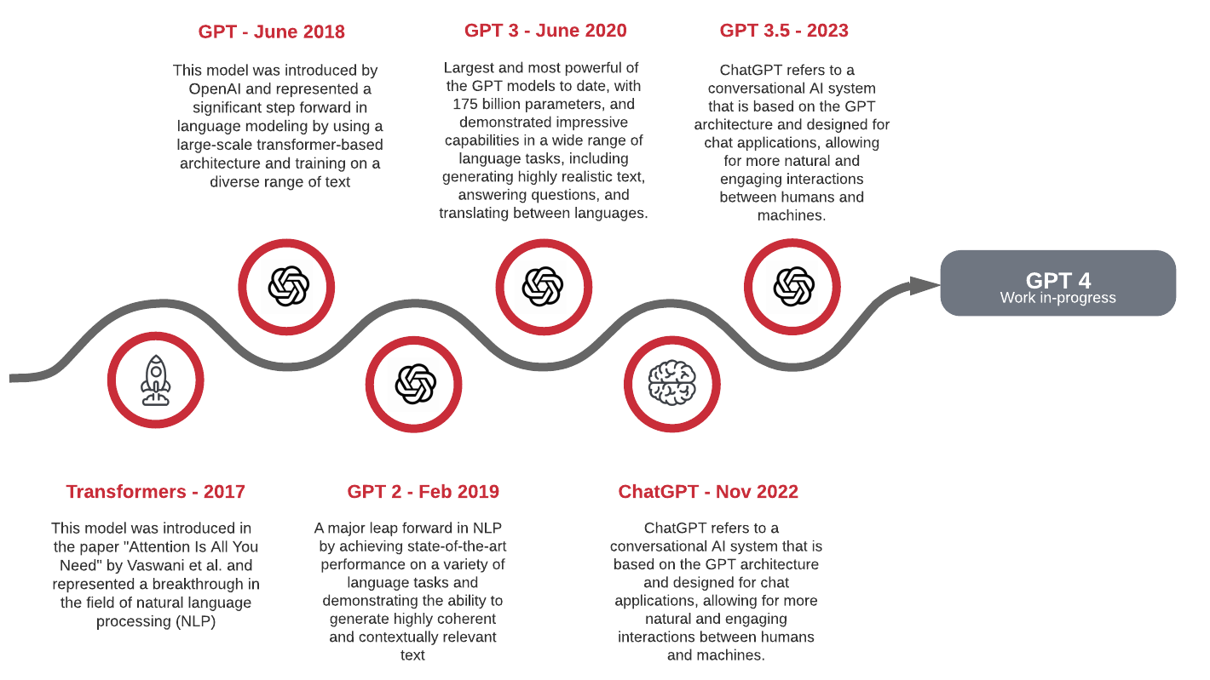
Evolution of GPT

Slide 8
What is ChatGPT and How does it work?
Practice in teams of 4 students
Industry expert mentoring to learn better
Get personalised feedback for improvements
9

Slide 9

What is ChatGPT?
ChatGPT is a AI chatbot developed by OpenAI, based on the GPT-3.5 architecture (GPT-4 in beta testing) which produces responses that closely mimics natural human language.
It has been trained on a vast amount of data, allowing it to generate accurate and contextually appropriate responses to user input.
ChatGPT can perform various tasks such as language translation, summarization, and question-answering.
It is a breakthrough technology that has the potential to revolutionize NLP and the way businesses interact with customers to understand and resolve issues efficiently.

Slide 10
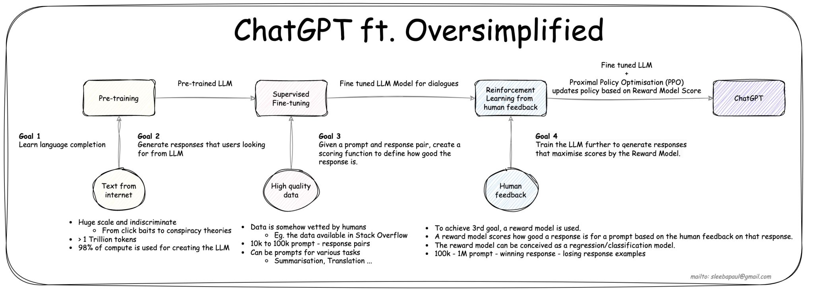
How does ChatGPT work?
Source: Sleeba Paul (LinkedIn)

Slide 11
Why is ChatGPT the most in-demand skill today?
Practice in teams of 4 students
Industry expert mentoring to learn better
Get personalised feedback for improvements
9

Slide 12
Why is ChatGPT the most in-demand skill today?
Automate
Automate tasks such as documentation, email writing, testing, summarization of missed meetings, etc.
Improve
Improve quality of work by proofreading documents, checking for plagiarism, and generating ideas for new projects
Expand
Expand your knowledge by accessing and processing information presented in language understood by all. This can help you to stay up-to-date on the latest trends and research.
Collaborate
Collaborate with others effectively across borders, translate and understand various languages effectively in real time
Develop
Create new products and services by integrating innovative technologies to capture target customers and stay ahead of the competition
Generate
Generate creative content such as poems, code, scripts, musical pieces, email, letters, etc. This can be used for entertainment, education, or marketing purposes.
Code
Generate and debug code. This can be helpful for developers who need to write code quickly or for people who want to learn how to code but don't know where to start.

Slide 13
How ChatGPT is transforming the future of industries
Practice in teams of 4 students
Industry expert mentoring to learn better
Get personalised feedback for improvements
9

Slide 14




How ChatGPT is transforming the future of industries
IT and Software Industry
Education
Used to troubleshoot problems, diagnose issues, and provide technical support. Co-pilots to generate and debug code easily which can be helpful for developers who need to write code quickly or for people who want to learn how to code but don't know where to start.
Used by schools and universities to create personalized learning experiences that are tailored to each student's individual needs. These models can generate interactive exercises and assessments, and they can provide feedback on student work..
Entertainment
Finance
Used by companies like Netflix and Disney to create new forms of entertainment, such as interactive stories and games. These experiences are more engaging and immersive and allow users to have a more personalized experience.
Used to analyze financial data and generate detailed reports. This can help financial analysts to make better decisions and to identify potential risks.

Slide 15




How ChatGPT is transforming the future of industries
Healthcare
Retail
Used to diagnose diseases, generate treatment plans, and provide patient education. These models can also be used to shortlist potential vaccines using clinical trials data which can speedup the vaccine development process
Used to personalize customer experiences, recommend products, and manage inventory. This can help retailers to increase sales and improve customer satisfaction
Law
Customer Service & HR Management
Used to research legal precedent, draft legal documents, and provide legal advice. This can help lawyers to be more efficient and to provide better service to their clients.
These chatbots can handle a wide range of customer inquiries, and they can often resolve issues more quickly and efficiently than human customer service representatives.

Slide 16
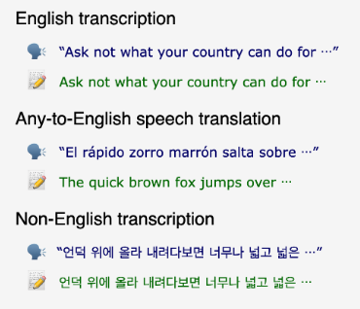


Some Trending Gen AI Tools
Open AI Whisper
Open AI Dall E
MidJourney

Slide 17
Prompt Engineering: Are you using effective prompts?
Practice in teams of 4 students
Industry expert mentoring to learn better
Get personalised feedback for improvements
9

Slide 18
Prompt Engineering: Are you using effective prompts?
Prompt engineering is the process of designing prompts that help large language models (LLMs) generate text, translate languages, write different kinds of creative content, and answer questions in an informative way
Prompt engineering is a rapidly evolving field, and there is no one-size-fits-all approach to designing effective prompts
Be specific
Be clear and concise in your prompts. The more specific you are, the better ChatGPT will be able to understand what you are asking
Provide enough context
Provide as much context as possible in the prompt to help the language model understand what is being asked
Avoid sensitive data
Avoid sharing sensitive, critical or personal information in the prompts because all the information will eventually be used to fine-tune the model
Provide examples
Include examples of the desired output to guide the model in generating accurate responses.
Test and Iterate
Continuously test and refine the prompts to improve the accuracy and relevance of the generated output
General principles for prompt engineering

Slide 19
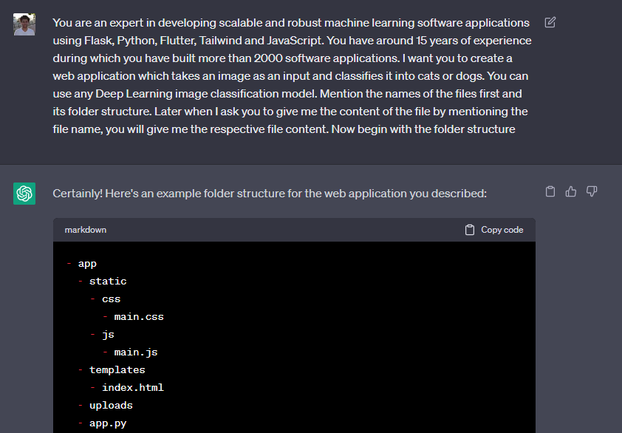
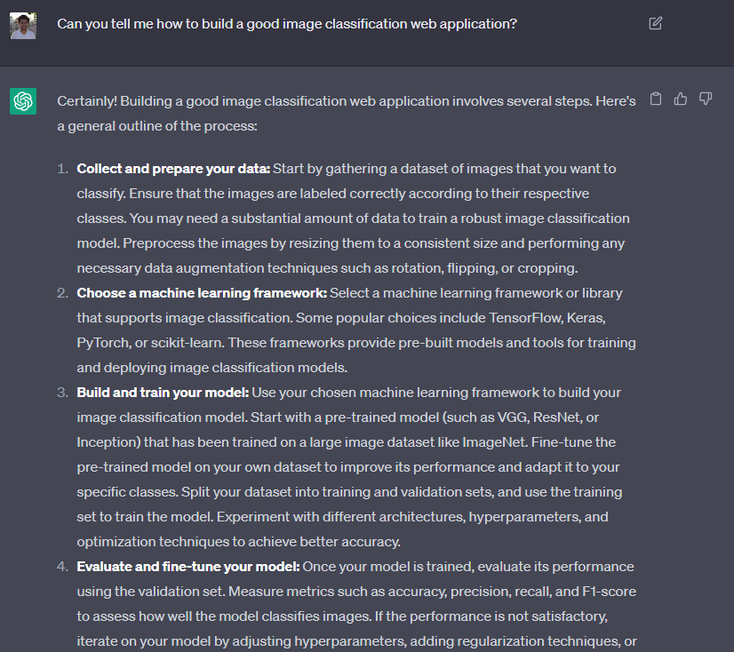

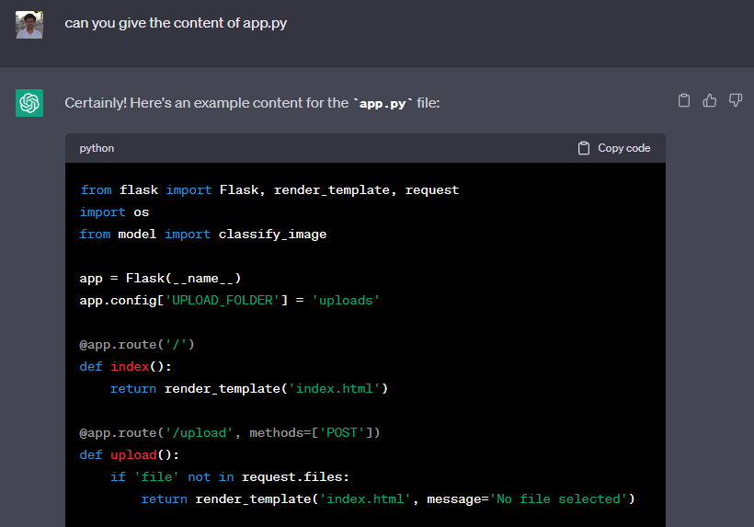
Convert Bad Prompts into Productive Prompts

Slide 20
Integrate Open AI’s APIs to Build your Custom Chatbot
Practice in teams of 4 students
Industry expert mentoring to learn better
Get personalised feedback for improvements
9

Slide 21
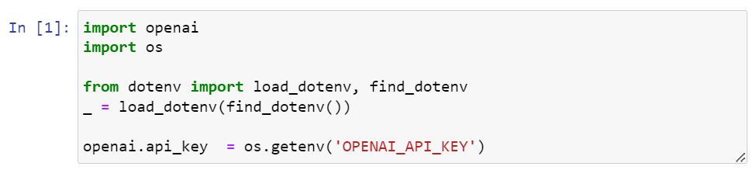
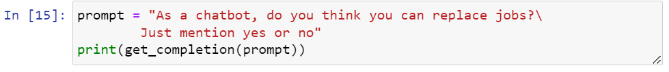
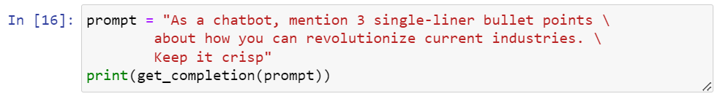
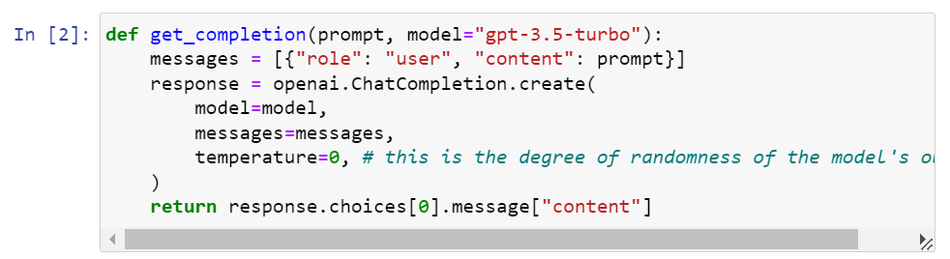
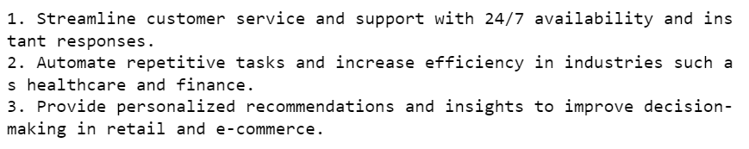
Initial Setup

Slide 22
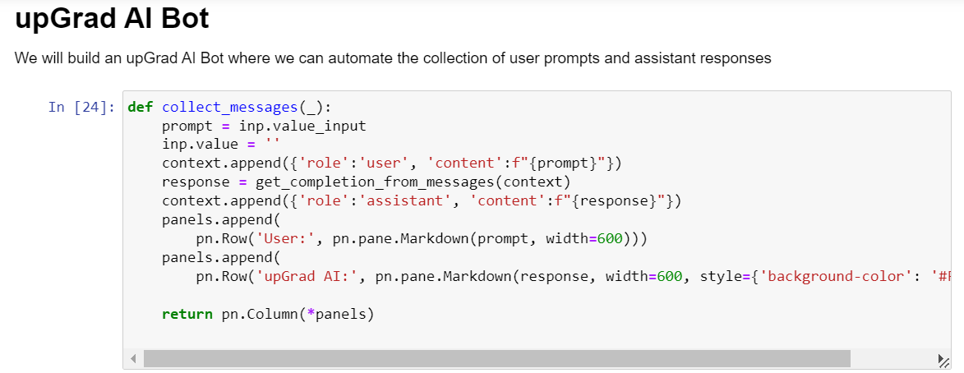
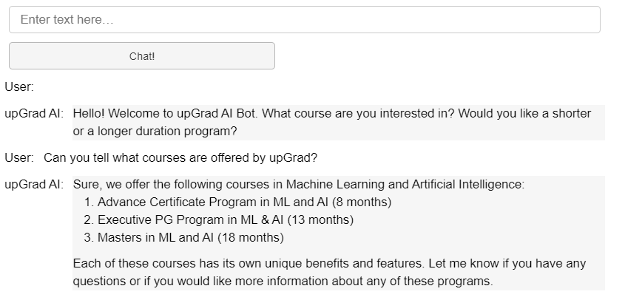
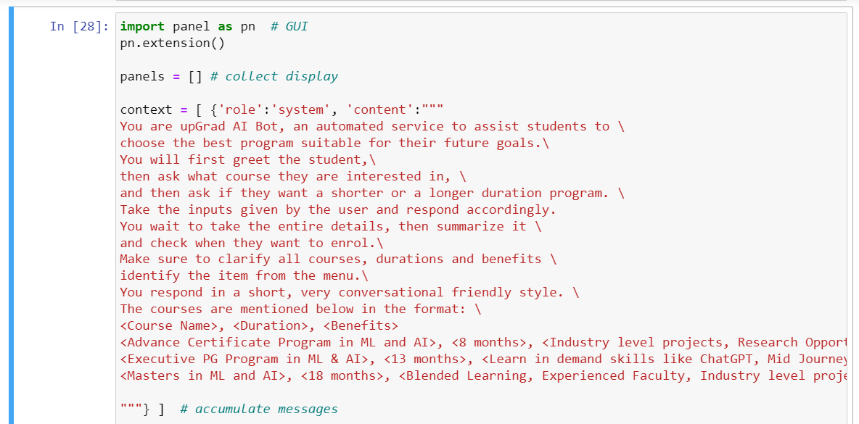
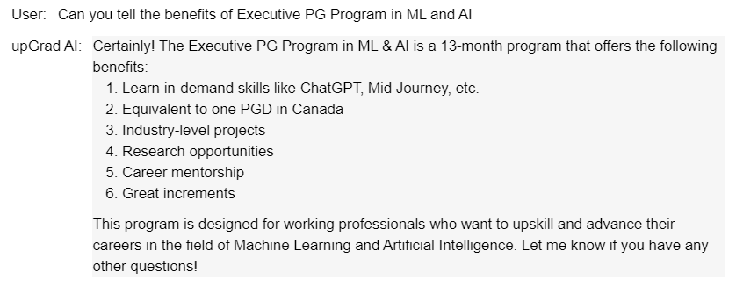
Build your Custom upGrad Chatbot

Slide 23
Limitations
Practice in teams of 4 students
Industry expert mentoring to learn better
Get personalised feedback for improvements
9

Slide 24

Limitations
Prone to hallucinations
Limited to text-based interactions
Bias in training data
Trained on Limited data
Lack of common sense
Gets complicated requests wrong

Slide 25

Summary
In this webinar, we:
Understood what Generative AI and Large Language Models (LLM) are
Traced the evolution of GPT
Decoded ChatGPT & its working
Understood why is ChatGPT the most in-demand skill today
Tips to get the best out of ChatGPT
Understood the limitations of ChatGPT

Slide 26


Questions and Answers
Practice in teams of 4 students
Industry expert mentoring to learn better
Get personalised feedback for improvements
Feel free to contact me:
arsalan.anwar.7777@gmail.com
https://www.linkedin.com/in/arsalan-anwar-ai/
9

